Slide 1

ASSIGNMENT EVALUATOR
RAJEEV RANJAN (CS16MTECH11012)
BHAGIRATHI NAYAK (CS16MTECH11004)
Notes:
It is using the background from https://dribbble.com/shots/1588545--Freebie-7-Low-Poly-Backgrounds-svg-png
Template modified by fppt.com

Slide 2

REQUIREMENT
The project is aimed at automating evaluations of C/ C++ programming assignments.

Slide 3
MOTIVATION
Manual evaluation takes up a lot of time.
The same time can be utilised for some other useful task rather than repeating the same tests for each student in the entire batch.

Slide 4
HOW THIS WORKS?
The evaluation just requires running a script which does all the work.
Even a non-technical person can evaluate the assignments.

Slide 5
FUNCTIONALITIES
It supports C/ C++ compilation.
Generates class performance report.
Generates report for each student for every test case (test cases failed/ passed).
Assigning grades to students based on given grading scheme
Automated mailing of reports to corresponding students containing detailed description of no. of test cases passed/ failed, marks deducted for each test case etc.

Slide 6
FUNCTIONALITIES
Timeout constraint per test case.
Partial matching of output
Plagiarism check

Slide 7
OUTPUT
Class performance
performance of each student
performance of student on every test case
Mark sheet of whole class
Test case input and output report
Plagiarism check report

Slide 8
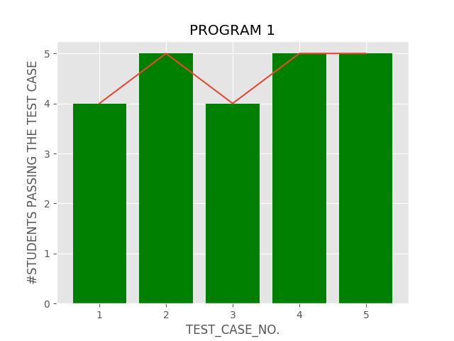
1.CLASS PERFORMANCE

Slide 9
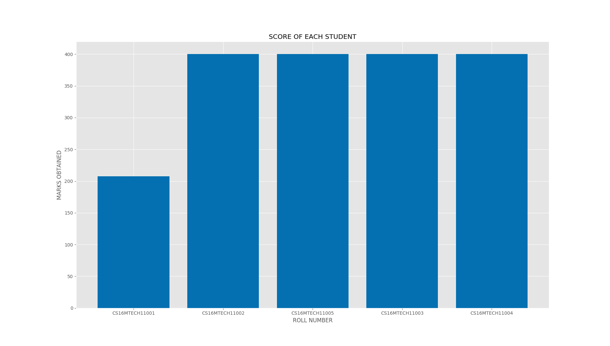
2.PERFORMANCE OF EACH STDUENT

Slide 10
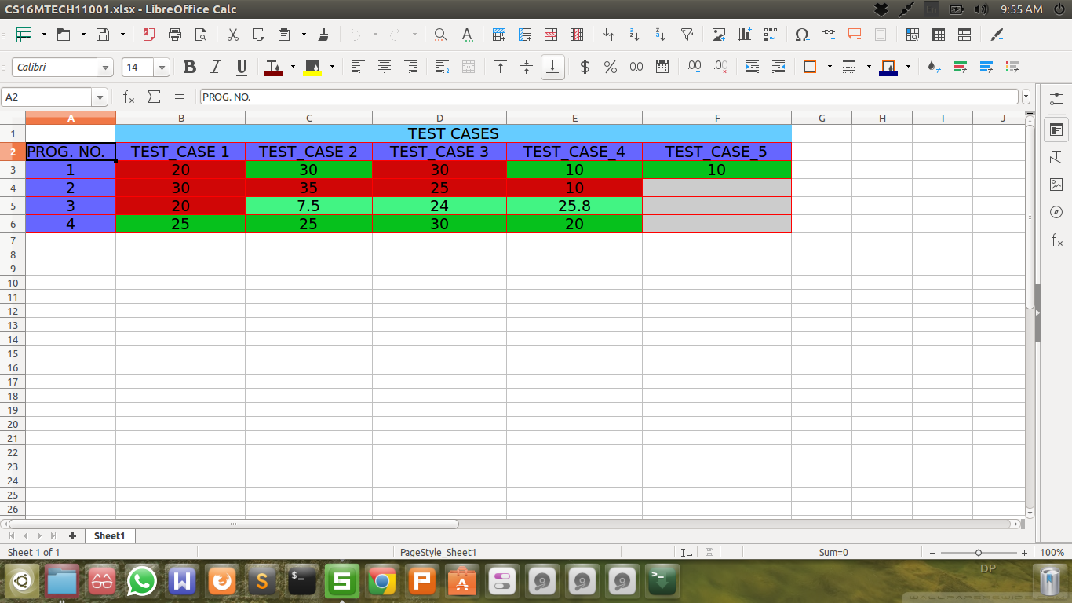
3.PERFORMANCE OF STUDENT ON EVERY TEST CASE

Slide 11
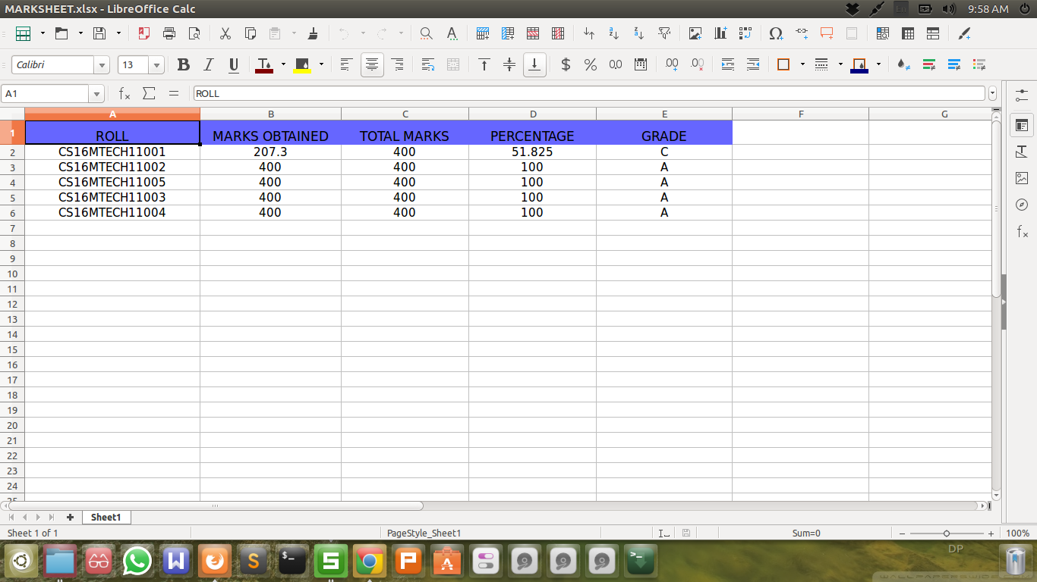
4.MARKSHEET OF WHOLE CLASS

Slide 12
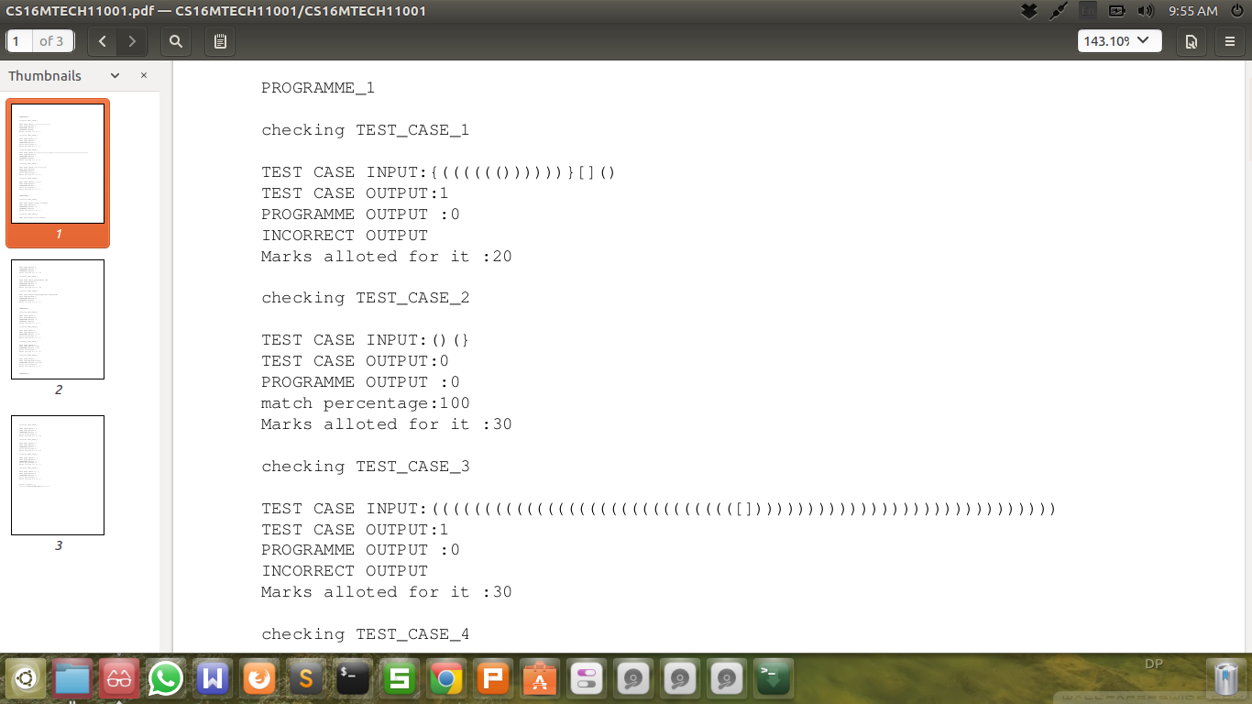
5.TEST CASE INPUT AND OUTPUT REPORT

Slide 13
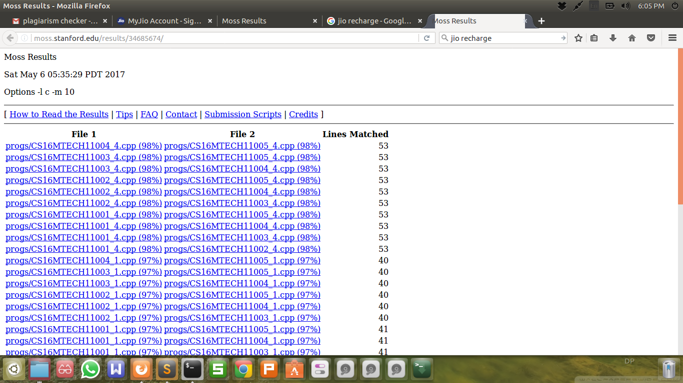
6.PLAGIARISM CHECK REPORT

Slide 14


